Slide 1
Interested in teaching?
The Ontario College of Teachers licenses, governs and regulates Ontario's teaching profession
Teachers who work in publicly funded schools in Ontario must be certified to teach in the province and be members of the College.
Private institutions: Teachers College is not needed (for now)

Slide 2

Best place to start: https://www.oct.ca/

Slide 3
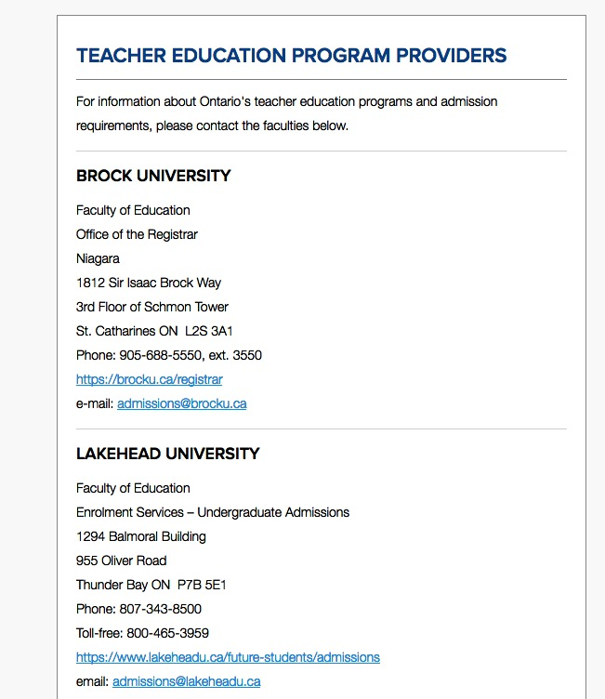
among other things you will find…

Slide 4


Slide 5
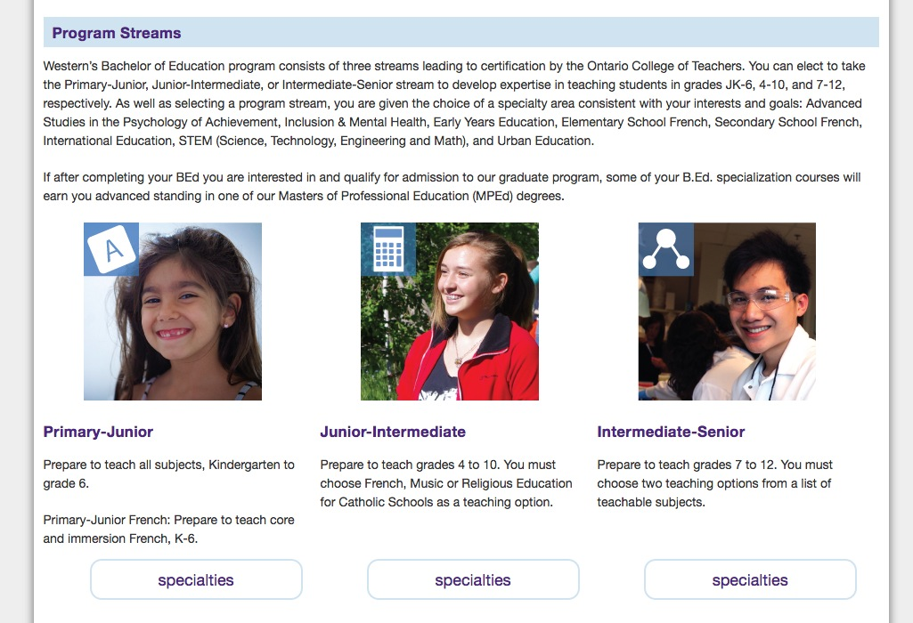

Slide 6
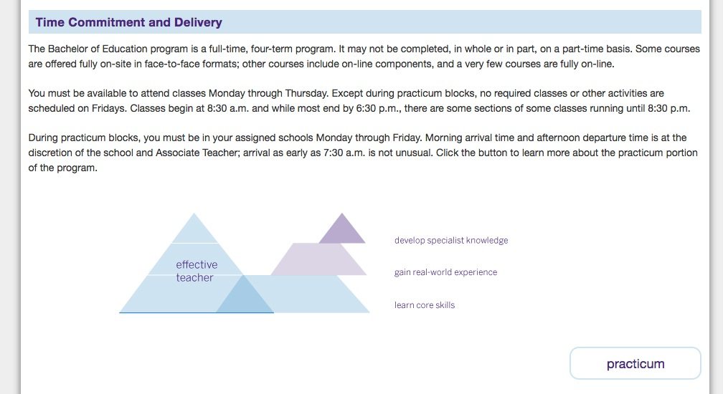

Slide 7
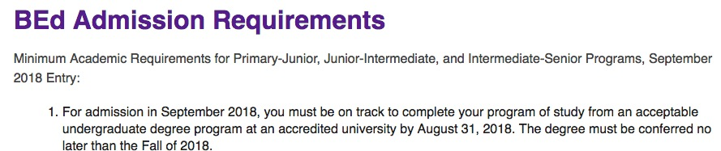
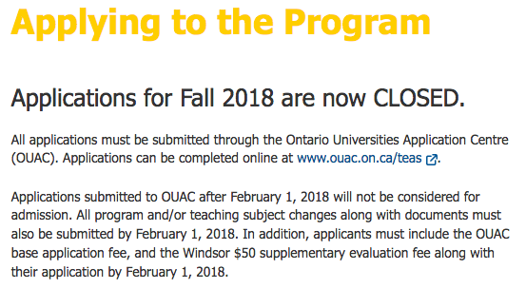

Slide 8


Slide 9

https://universitymagazine.ca/teacher-positions-demand-ontario/

