Slide 1
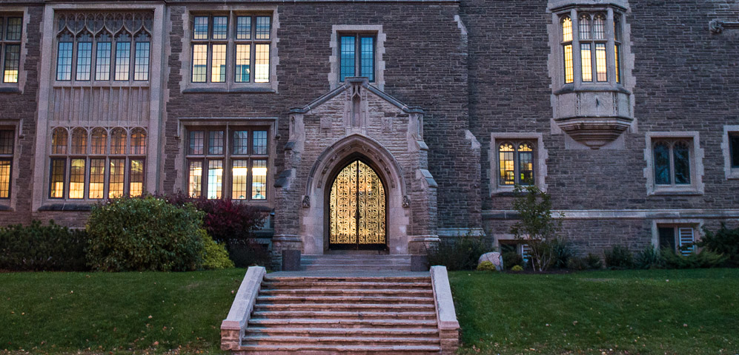
Financial Mathematics

Slide 2
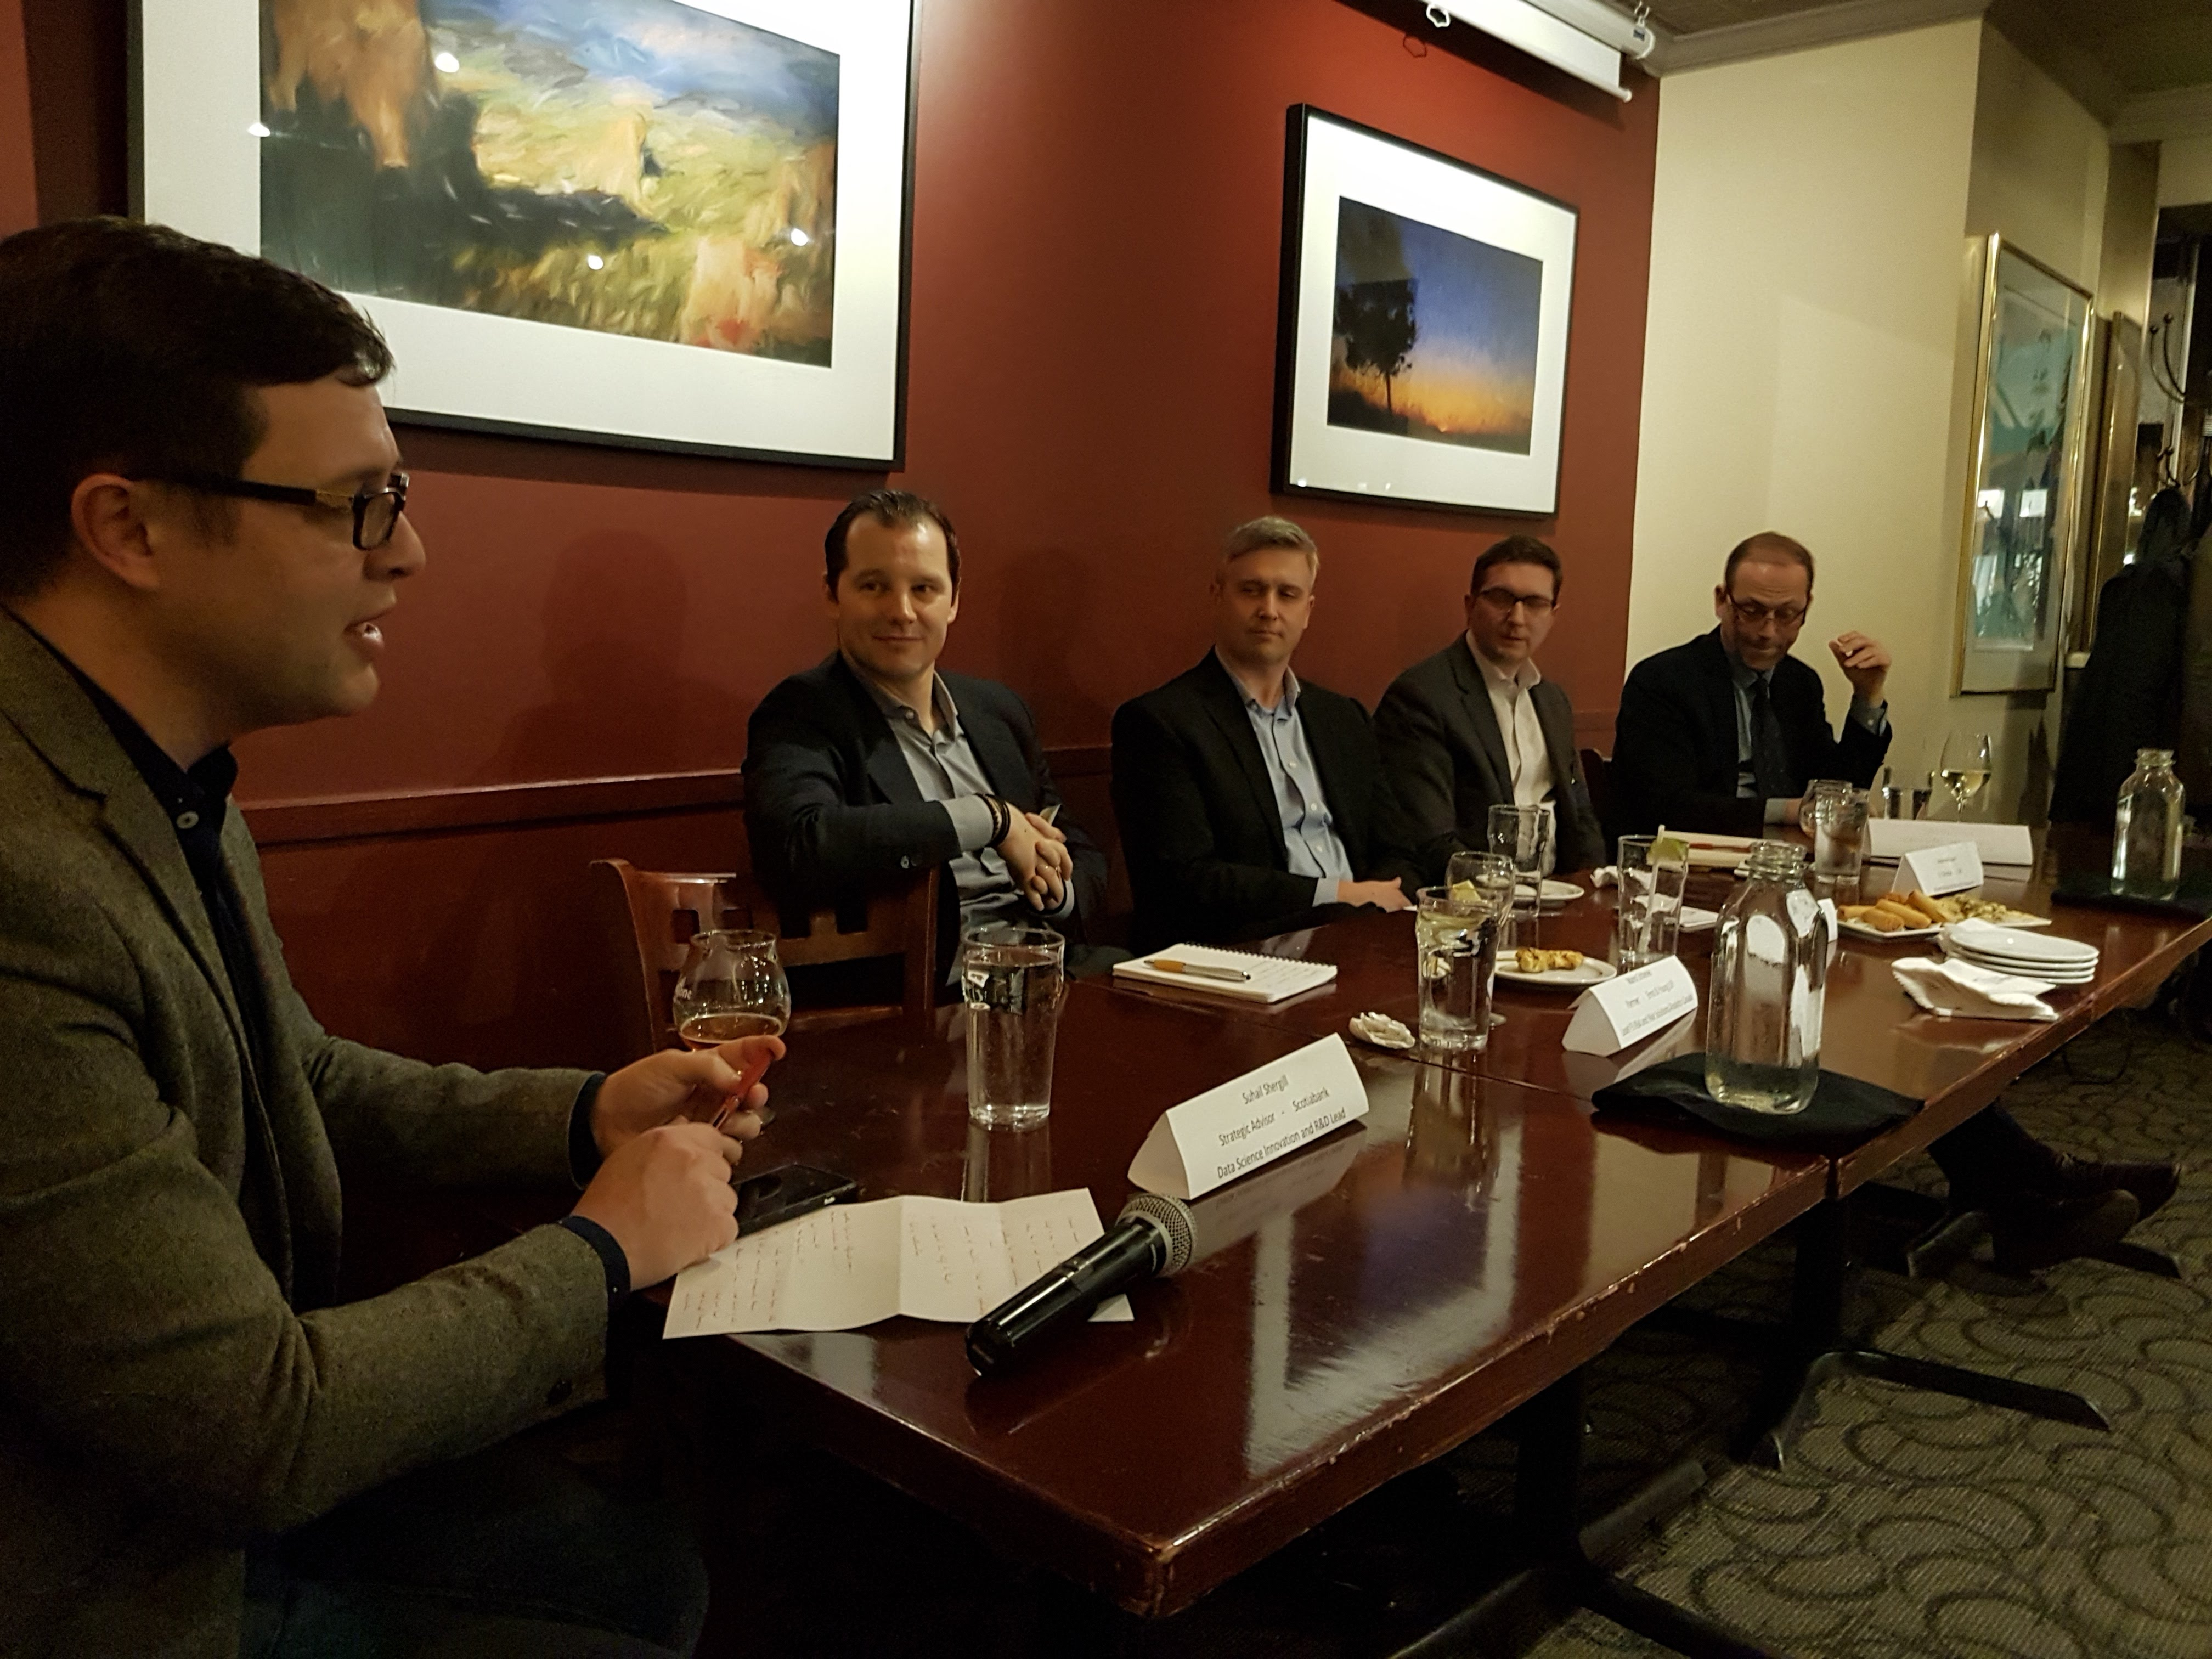
Aside on Actuarial Careers
Actuarial careers typically math of insurance
(blending probability and Math2FM3)
Typically begins straight out of undergraduate, does not involve graduate study unless coming from a non-actuarial program
Consider graduate programs
in Comp Sci, Statistics
Need to write 2 to 5 exams
Co-op experience

Slide 3
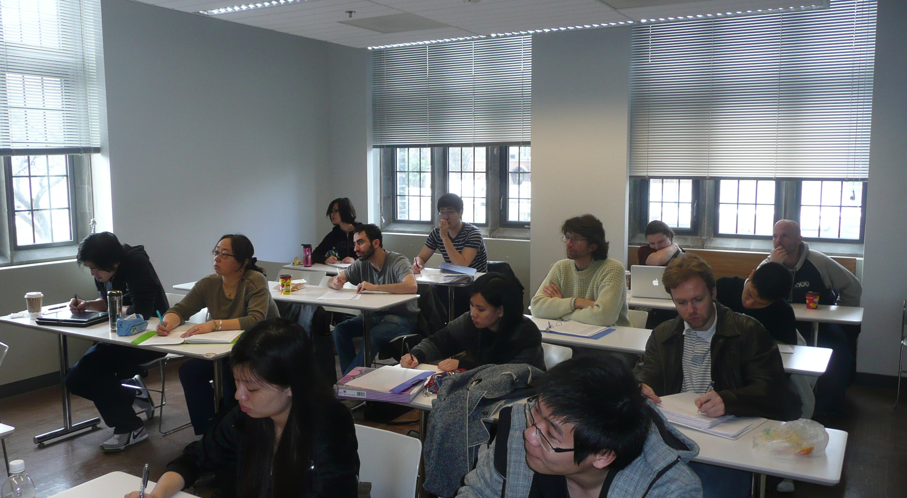
Financial Mathematics
Mathematical models for pricing and risk associated with stocks, interest rates, fx, commodities, credit risk
Begin to see in Math3FM3 and Math4FM3
At least a one year professional Masters
Main 3 in Canada are McMaster (12 month program), Waterloo and U of T (16 months)
Others offered by York, Western, other universities in other provinces

Slide 4
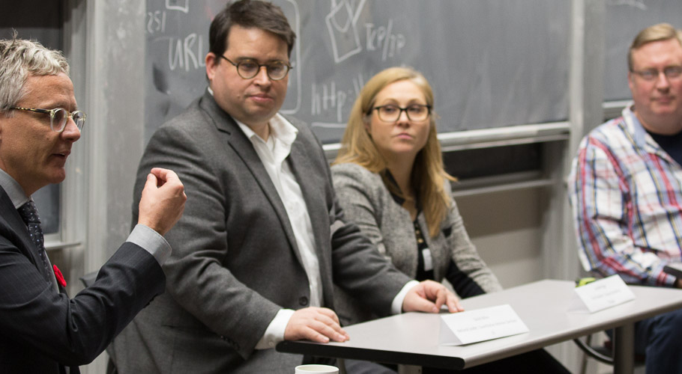
M-Phimac Application
Strong performance (minimum B+ average) in 3rd and 4th year mathematics
We like to see courses like real analysis, advanced probability, PDEs
Financial math good, but not necessary
Programming, statistics, business/econ good
Non-academic interests

Slide 5

M-Phimac: Two Aspects
1. Academic studies of financial mathematics
no prior financial math knowledge required
2. Professional development
Communication, language, interpersonal skills
Weekly sessions
Interwoven in courses
Alumni network,
mentoring, industry
events, industrial guests

Slide 6
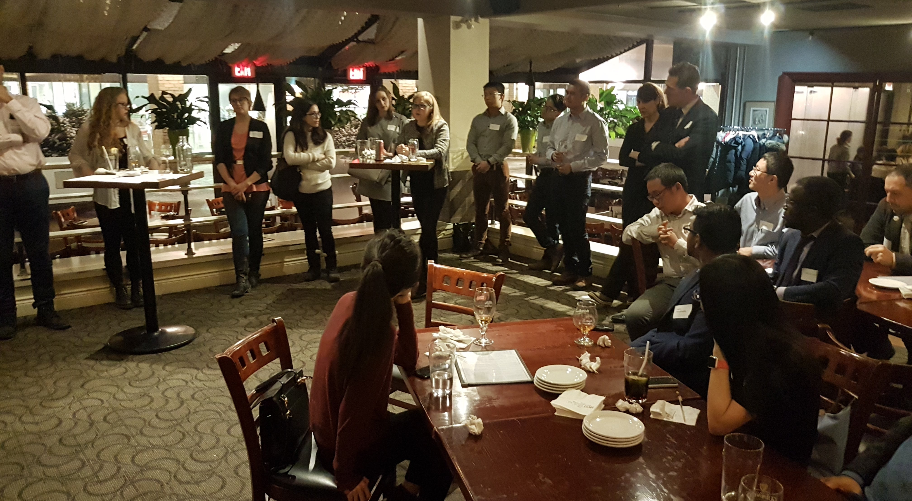
M-Phimac Program
8 months of intense
coursework with prescribed courses
4 month summer industrial project
Program and SCCE work with students on placement
Flexibility in how the summer industrial work is done
Paper and presentation to complete end of August
Tuition $23,500 domestic/PR and $45,045 for international
No scholarships or financial aid available

Slide 7
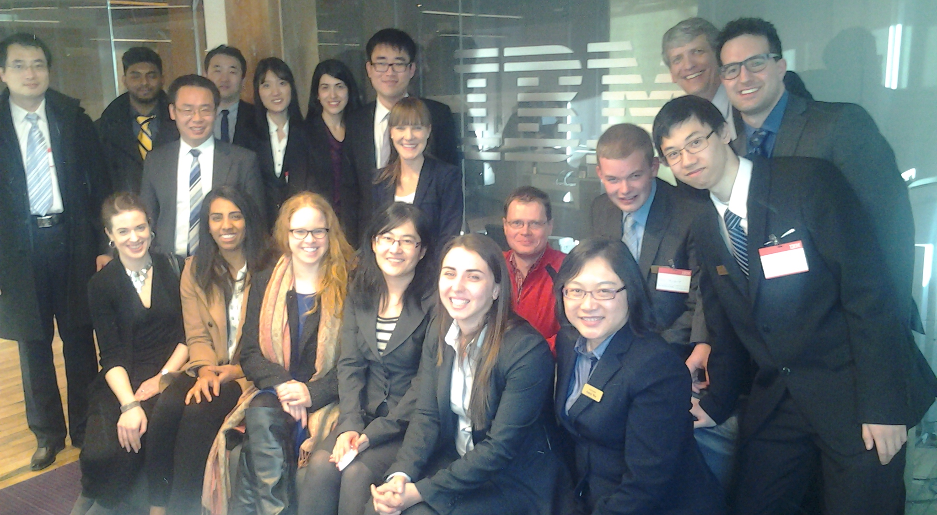
Careers
Historically, close to 90% placement
Almost all in Toronto; 75% in big 5 banks
Risk measurement and management (market risk, credit risk, new forms of risk)
Pricing and vetting
Capital assessment
and allocation
Modeling market
factors and positions

Slide 8
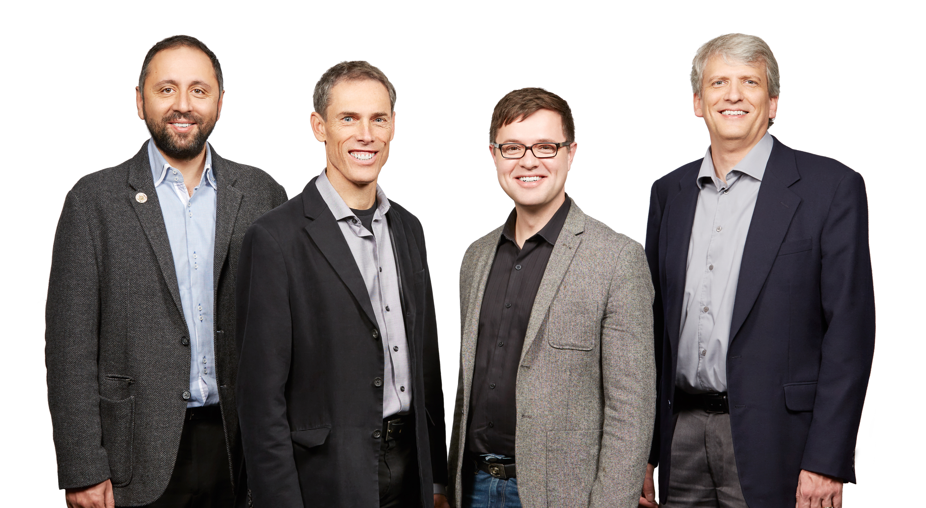
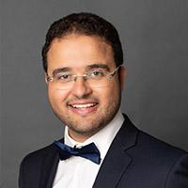
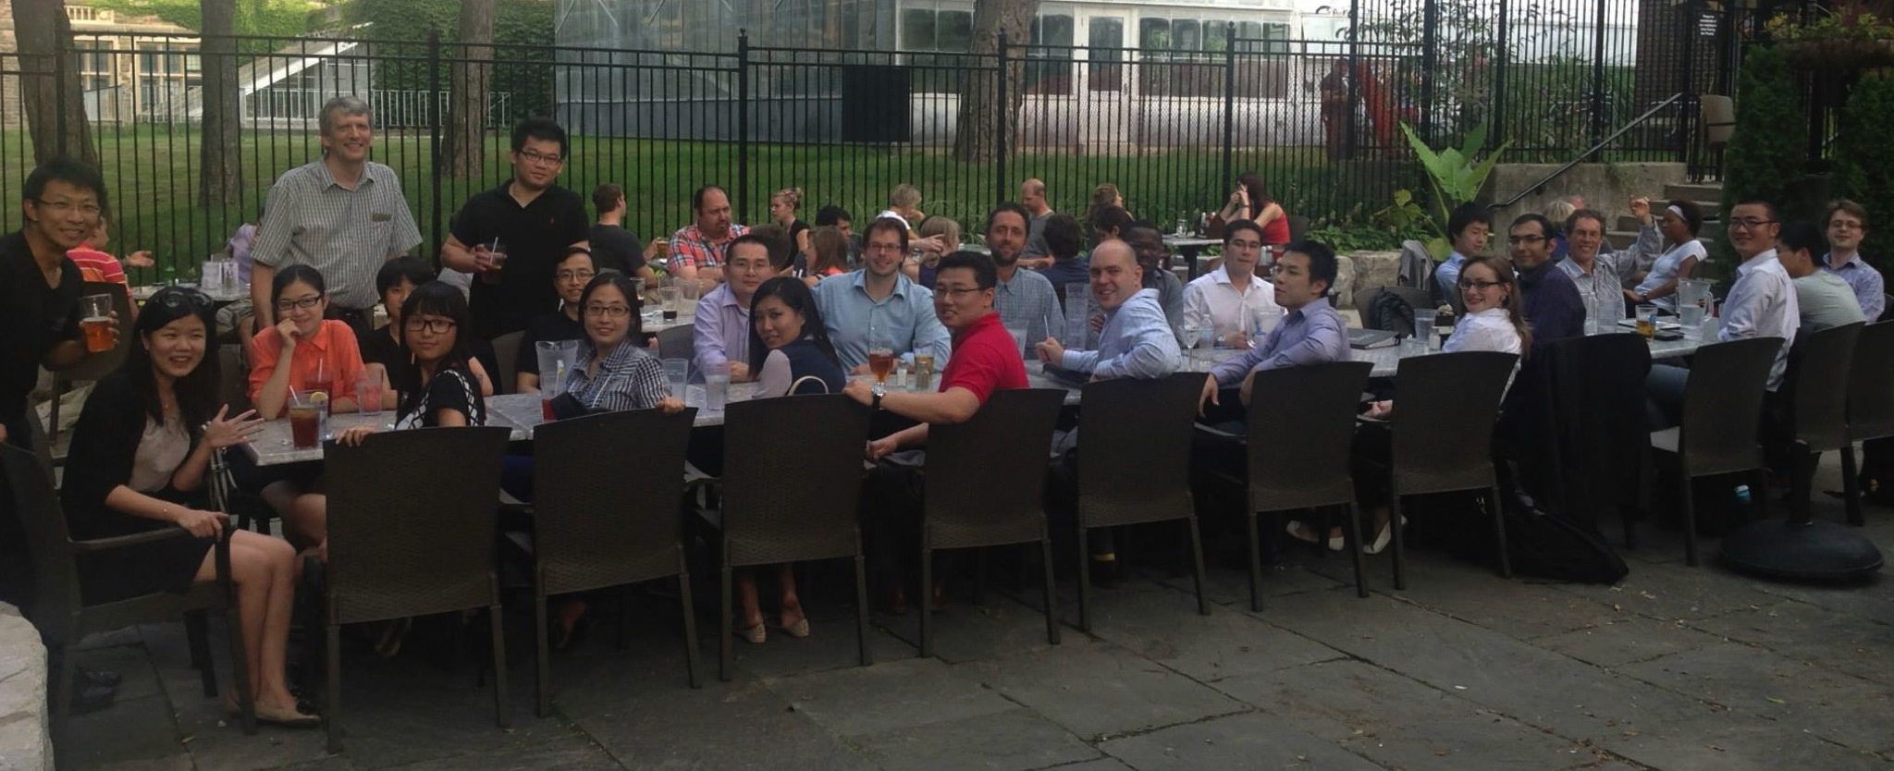
Questions?

