Slide 1
Delivering Innovation Through Research, Development and Training
Rebecca Bourque, MSc
Director of Business Development and Strategic Accounts

Slide 2
Research talent supply chain
Why Mitacs?
Attract
Train
Retain
Deploy
Best and brightest research talent to Canada
With employment-ready skills and experience
Talent locally to enhance Canadian economy
Researchers to drive innovation outcomes
Notes:
Mitacs aims to:
Attract the best and brightest researchers to Canada
Train students through professional development workshops and hands-on research with industry
Retain talent locally in Canada, to benefit the local economy and innovation sector
Deploy researchers where their talents and knowledge are most needed, to drive innovation.

Slide 3
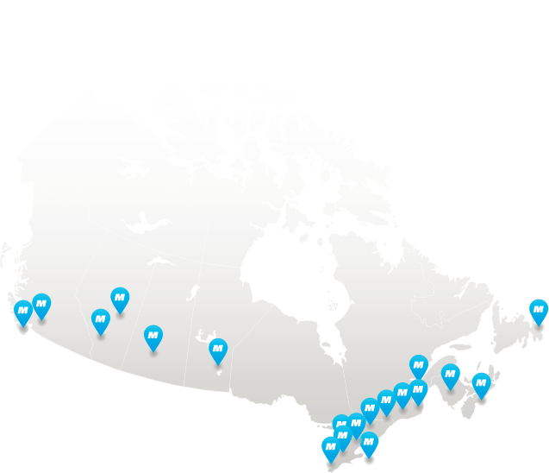
Why Mitacs?
National research network
18 years in operation
20,000+ research projects
65+ academic partners
Notes:
Our research collaborations help companies overcome R&D challenges and drive innovation
Why is Mitacs different?
Can be scaled to suit the size of the research project with 1-to-many interns
Fast application approval
Access researchers from any discipline, from STEM to social sciences
Programs open to all students including international students.

Slide 4
Mitacs by the Numbers
Why Mitacs?
Notes:
This includes #’s up to 16/17.

Slide 5
Program growth
Why Mitacs?
Mitacs research projects
Notes:
Research figures cover Mitacs Accelerate, Globalink, Elevate and Enterprise programs from 2003/04 to 2015/16

Slide 6
The Mitacs network
Why Mitacs?
Computer science
Engineering
Anthropology
Economics
Chemistry
Geography
Health sciences
Genetics
Social work
Forestry
History
Languages & linguistics
Mathematics
Business
Education
Interactive arts
Psychology
And more…
Small & medium business
Large business
Not-for-profit organizations
Notes:
Mitacs internships are open to all disciplines, including Science, Technology, Engineering and Math, along with the social sciences and humanities, business, medicine and the arts.
We partner with organizations of all sizes. Select not-for-profits are able to participate in Mitacs programs.

Slide 7
Mitacs program goals
Support flexible, collaborative research projects
Attract new funding
Maintain high-quality research
Support all disciplines
Support international research collaborations in Canada and abroad
Train graduates and postdocs for their careers
Industry

Slide 8
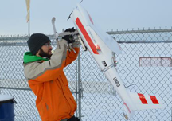
Building research collaborations
Small and large-scale, multidisciplinary projects defined by industry or non-profit partner
From $15,000 to $2M+ in funding
Supports grad students and postdocs in all disciplines
Non-competitive: apply any time
Peer reviewed; quick turnaround
Notes:
Mitacs Accelerate supports small- and large-scale research projects, from $15,000 up to $2 million across all industries and disciplines.
Most applications are approved within 6-8 weeks.

Slide 9
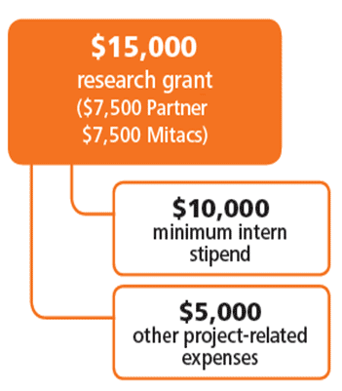
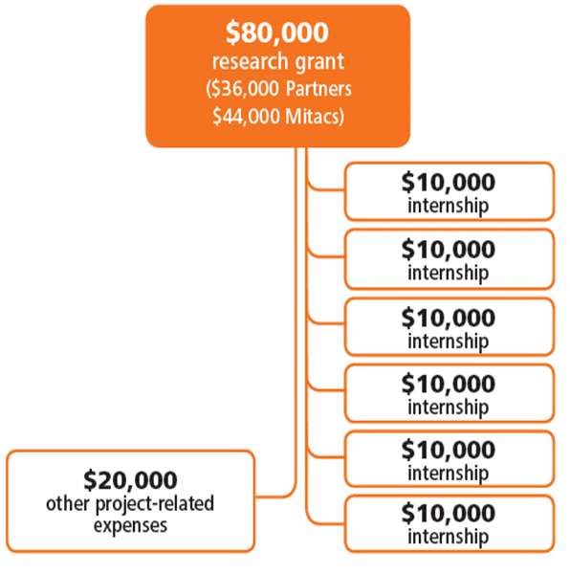
Funding Model
Mitacs Accelerate
Standard
Cluster: 6 or > internships & 3 or > interns
Notes:
The model for Accelerate is built on blocks of four-month internships. The partner and Mitacs contribute matching money for each internship unit.
The university receives the funding and funds the student.
A portion goes to expenses.
Funding starts at $15,000 per four-month internship, but can scale into the millions.

Slide 10
Partners
Mitacs Accelerate
Business with facilities operating in Canada
For-profit and crown corporations
Domestic or foreign-owned
Utility providers, NGOs
Eligible not-for-profits
Projects must demonstrate economic or productivity orientation
must be incorporated as a not-for-profit organization

Slide 11
Partner’s Eligibility
Mitacs Accelerate
1. Is the partner
a for-profit or
a crown corporation receiving no more than 50% of their revenues from government sources?
2. Is the partner
a hospital, university, municipality, health authority, or government?
3. Is the partner
a registered not-for-profit organization or charity?
No
No
Yes
Yes
Yes
Does the project demonstrate an economic or productivity orientation?
(Ask us for 1 page pre-assessment form)
NOT ELIGIBLE
No
Yes
APPLY

Slide 12
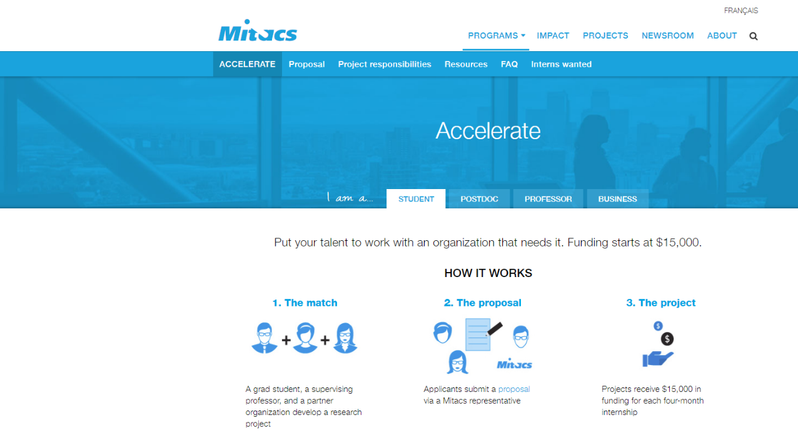
programs
projects


Slide 13
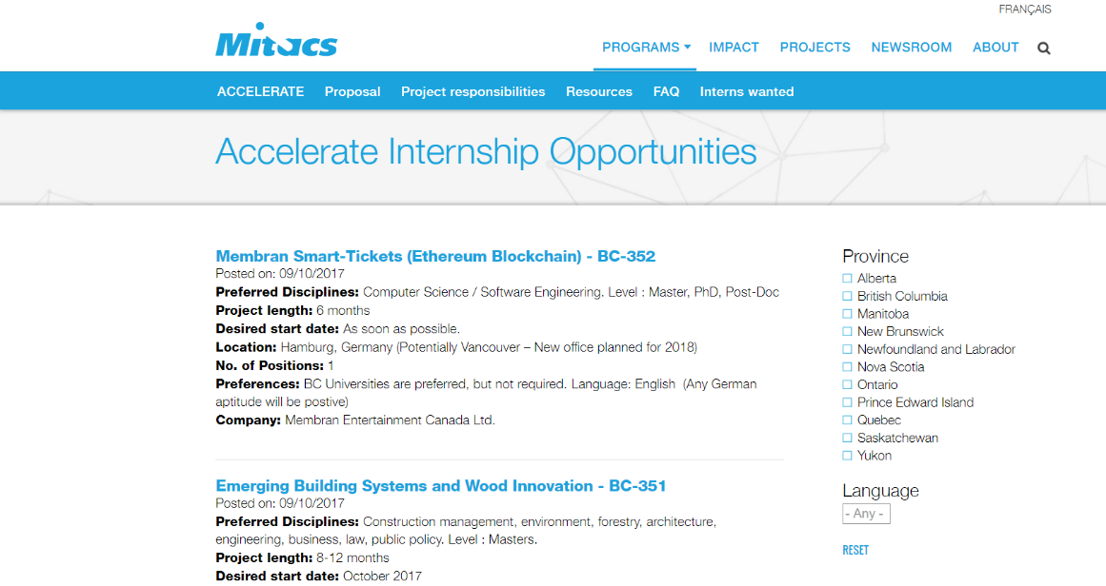

Slide 14
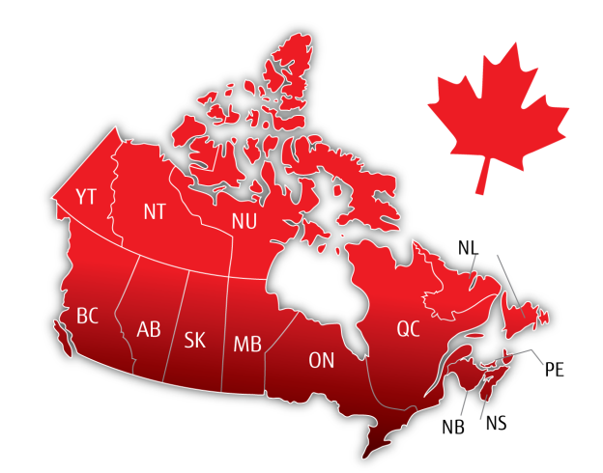
Two-way mobility opportunities
Mobility initiatives for students
Research Internship
Graduate Fellowship
Research Award
Accelerate International
Research Award
Accelerate International

Slide 15
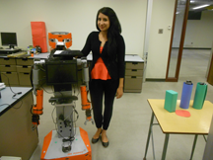
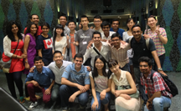
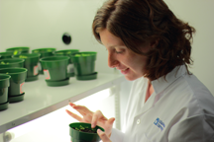
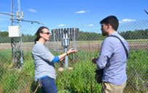
International opportunities
Research collaborations for senior undergraduate and graduate students in Canada and abroad
Bringing the world’s brightest students to Canada
Overseas research opportunities for students in Canada in academia or industry

Slide 16
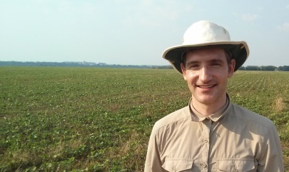
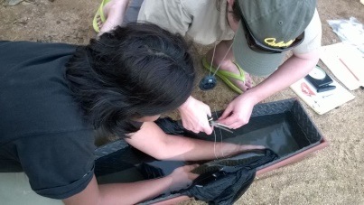
Globalink Research Internship
12-week research internship for students from Mitacs partner countries
Supervised by faculty member at a Canadian university
Open to international undergraduate students
Partner countries: Australia, Brazil, China, France, India, Germany, Mexico, Saudi Arabia, Tunisia, and Ukraine
Competitive annual application – only top-rated students are selected

Slide 17
International projects with companies
Accelerate International
Research collaborations between international companies and graduate students, faculty at Canadian universities
$15K per project
16–24 weeks (75% abroad, 25% home university)
All disciplines, no application deadlines
Any country
Out
Research collaborations between Canadian companies and graduate students, faculty from France, Israel, Mexico, Norway
$15K per project
16–24 weeks (75% at Canadian company, 25% home university)
All disciplines, no application deadlines
In

Slide 18
Globalink Research Award
$6,000 grant for research at an international university
Open to senior undergraduate and graduate students in all disciplines
12–24 weeks
For travel in the summer, submit applications in January/early February
Partner countries: European Union, United States, UK, Australia, Brazil, China, India, Japan, Israel, Korea, Mexico, Norway, Saudi Arabia and Tunisia

Slide 19
What is needed:
Globalink Research Award
Go to the Mitacs website first!
Find an academic supervisor at home and at host university
Discuss and agree on the project to conduct
Define your dates of travel and check timelines for visas
Fill in the application form and have it signed by ORS
Apply!
Award answer to be received 10-12 weeks
after submission

Slide 20
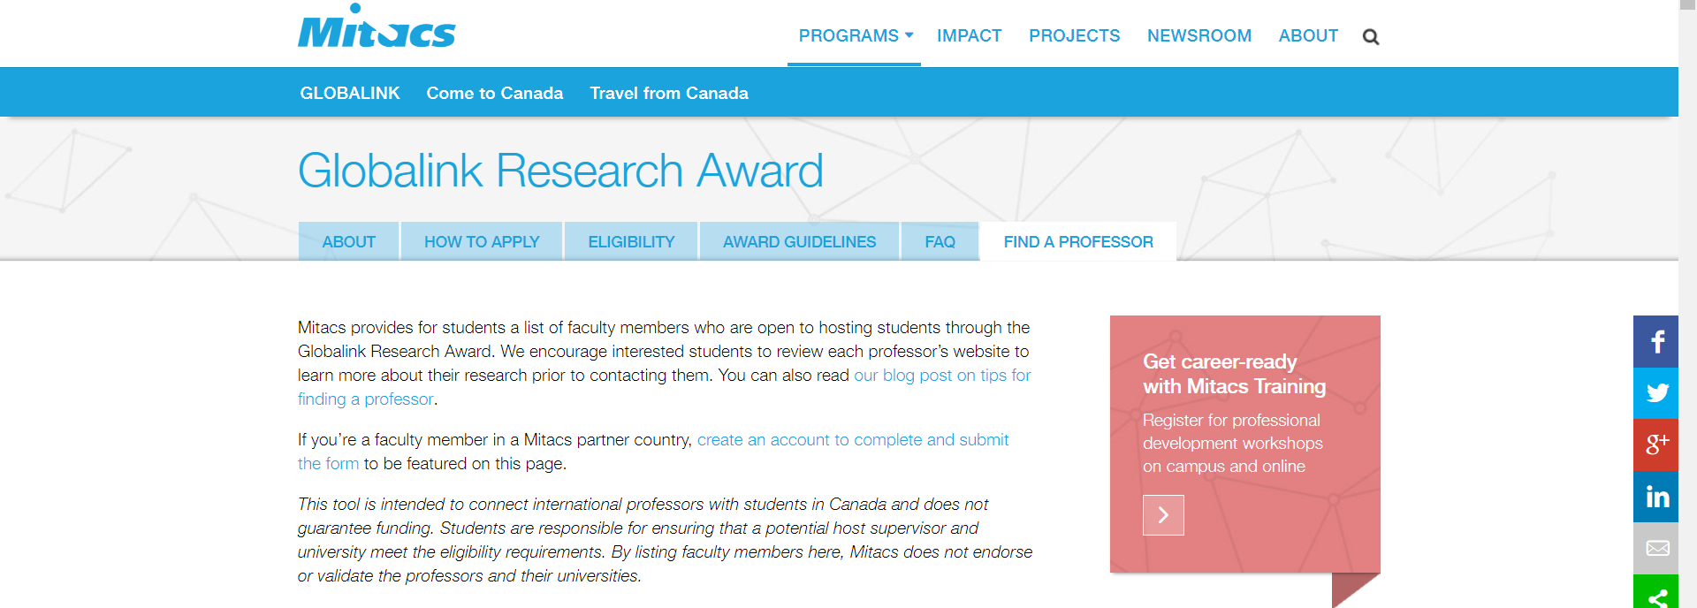
Find a Professor Abroad
https://www.mitacs.ca/en/programs/globalink/globalink-research-award

Slide 21
Professional development exclusively for researchers
Taught by industry professionals
For graduate students and postdocs
Transferable skills increase employability
No charge to participants
Workshops include leadership, management, communications, relationship building, entrepreneurialism

Slide 22
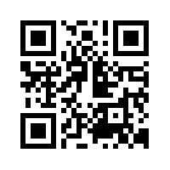
Next steps
Contact us to discuss:
Register to receive updates: www.mitacs.ca/signup
Rebecca Bourque
rbourque@mitacs.ca
Ryan Caldwell
rcaldwell@mitacs.ca

