Slide 1

McMaster University
MATH 2C03
Course Key: mcmaster 9699 1336
Lia Bronsard

Slide 2
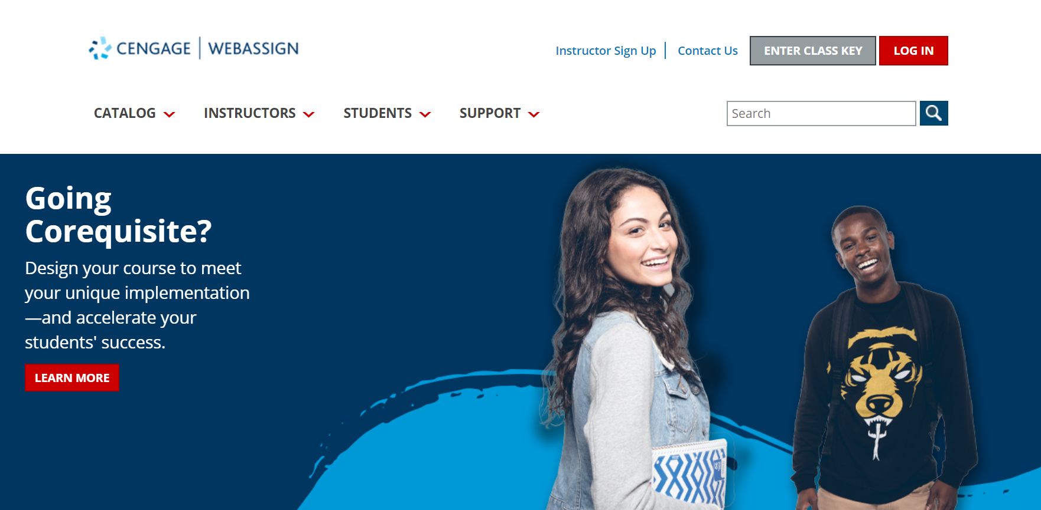
Get Access
Go to webassign.com and click ‘Enter Class Key.’

Slide 3
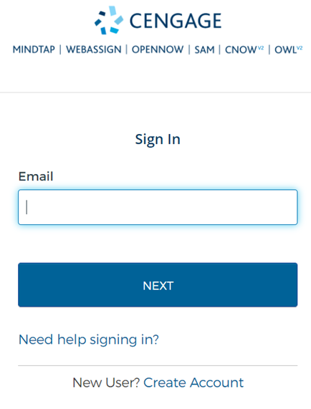
Login to Your Account
A) Used WebAssign, MindTap, or another Cengage platform before? You have an account.
Login.
OR
B) Create a New Account
A
B

Slide 4
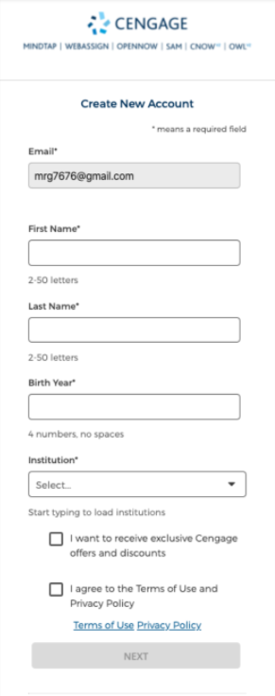
New Users – Create Account
Complete the Account Information form.
We suggest you use a school issued email address and your full name – no nicknames.
Click Create Account
Check your email for the verification email from Cengage
Check your junk/spam folder if you can’t find it at first.

Slide 5
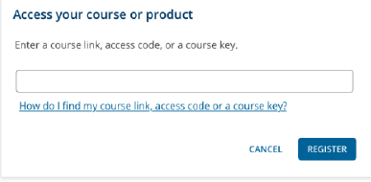
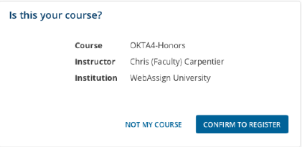
Enter Class Key
Enter in your class key & click “Register”
mcmaster 9699 1336
Confirm the course information that displays is correct and click “Confirm to Register”

Slide 6
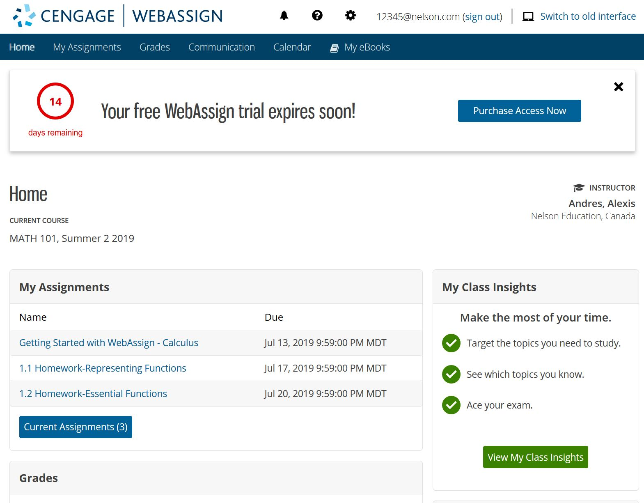
Access Options
Now that you have accessed your WebAssign account, you have a 14-day grace period from the start of classes before you must enter your access code as proof of purchase.
Clicking Purchase Access Now will allow you to:
A) Purchase an access code if you haven’t purchased one yet, or
B) Enter an access code if you have purchased it already

Slide 7
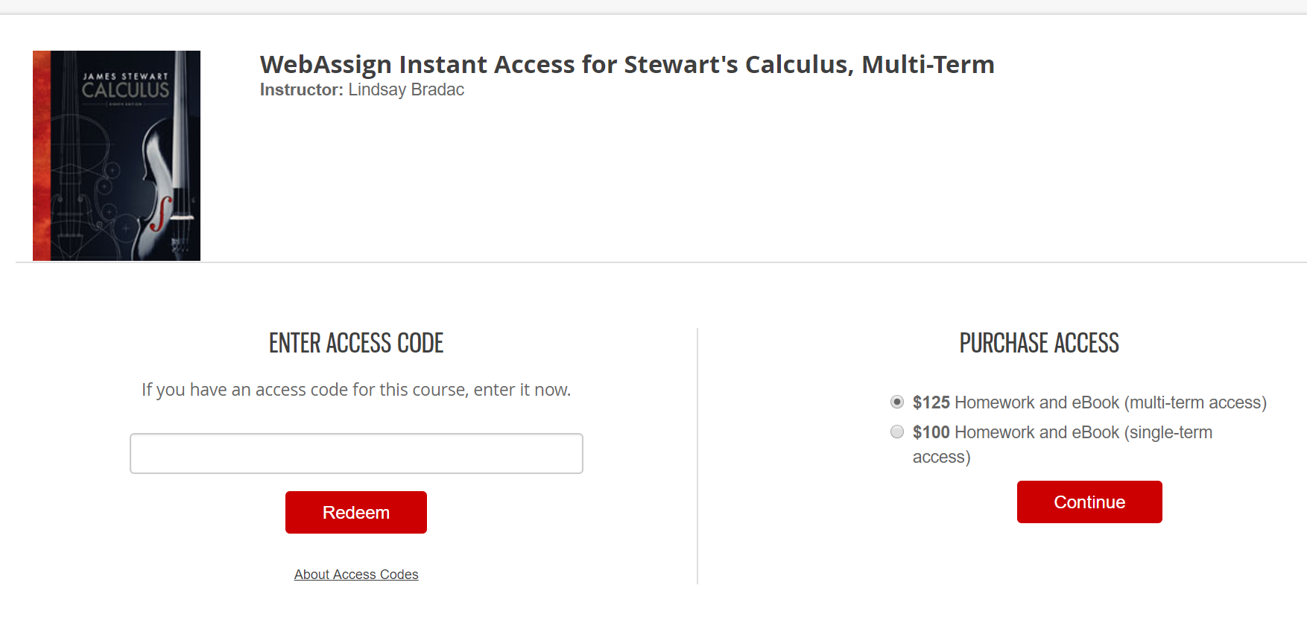
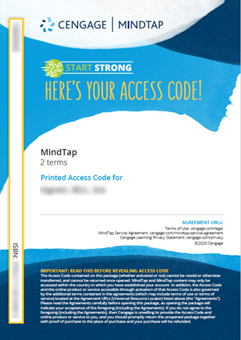
Redeem or Purchase Access
If purchased access from another source (ex: your campus bookstore) or have an access code card, enter it into the box and click Redeem.
Purchase access HERE
If you purchase from Cengage.ca, make sure you use the same email address as you did to login to WebAssign.
Your access code will be automatically applied to your account.
Access Code Card

Slide 8
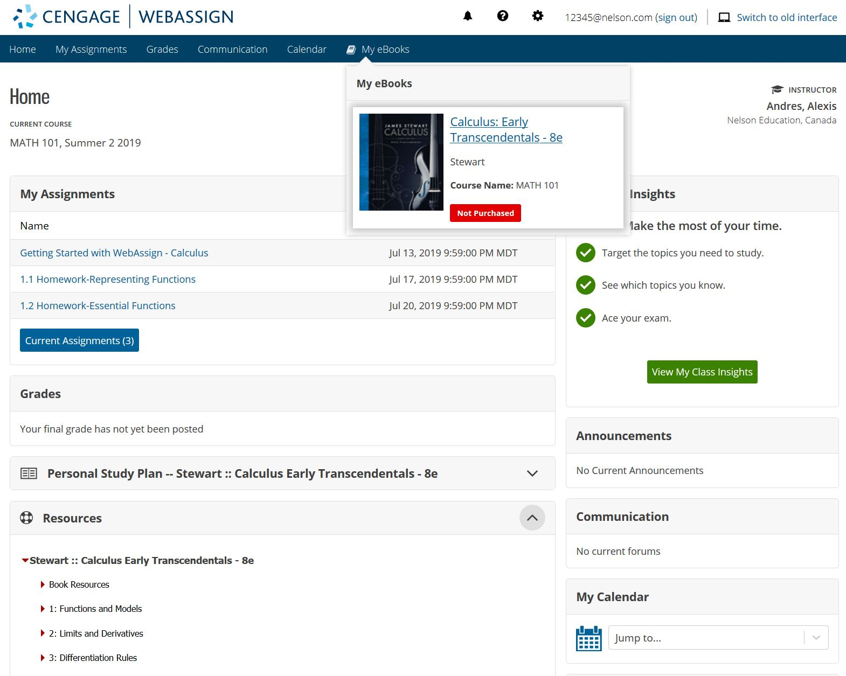
You’re All Set!
That’s it! You’ve successfully registered for WebAssign!
The course that has been set up for you by your instructor(s) appears on your personalized homepage.
From the homepage you can access:
A) Your Assignments
B) Your eBook
C) Your Grades
If you have more than one course, simply select the course you want to work with from the pull-down menu.
A
B
C

Slide 9
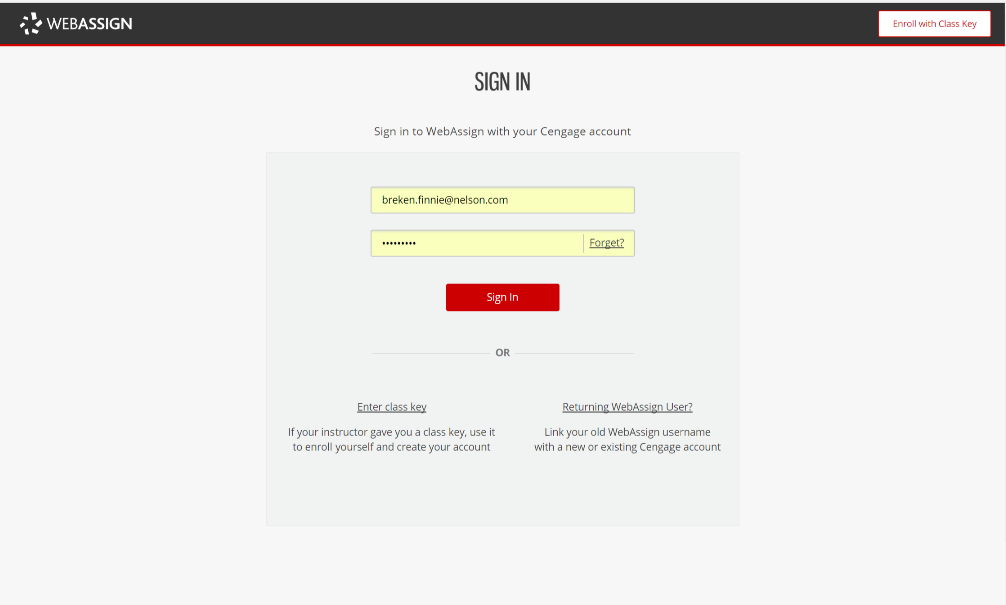
Returning to Access WebAssign
Sign into your account with your username and password here:
https://www.webassign.net/wa-auth/login

Slide 10
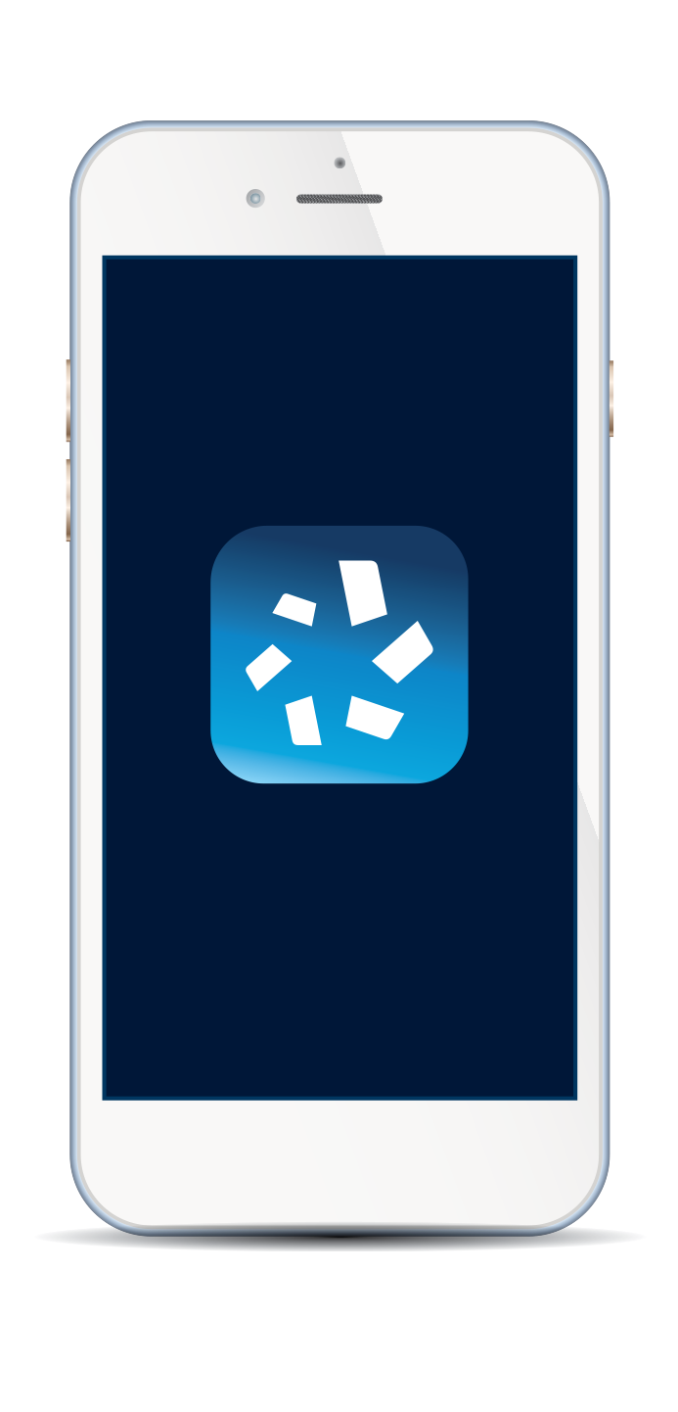



Get Mobile and Go!
You have free access to the Cengage Mobile App. With it, you get mobile access to all your Cengage eTextbooks!
Find it in the App Store or Google Play

Slide 11
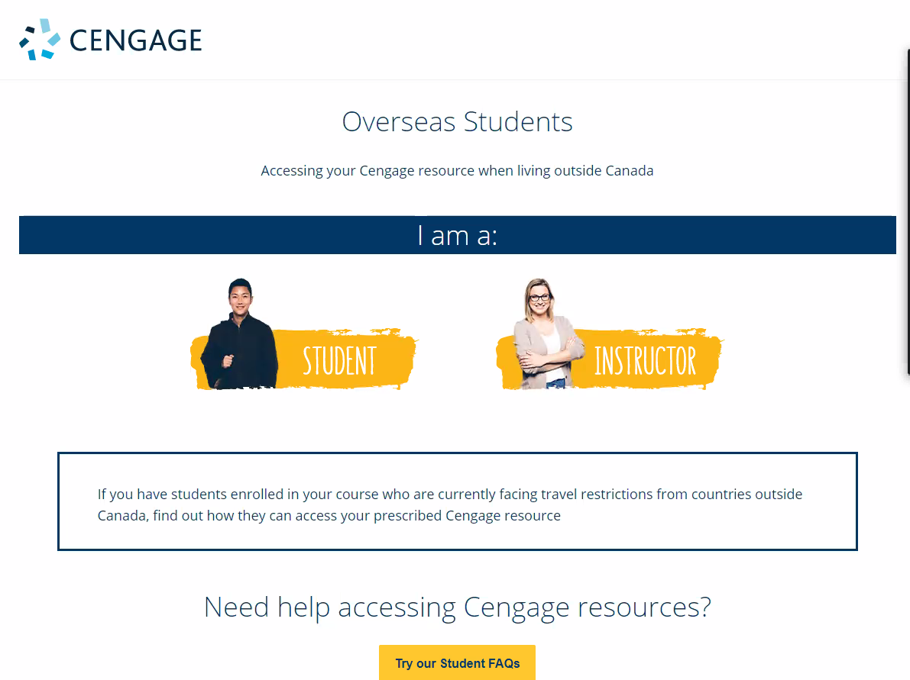
Outside Canada?
Go to this link:
info.cengage.com/international
Click Student
Click the option for your location to learn how to purchase your Cengage Canada materials
International Students

Slide 12

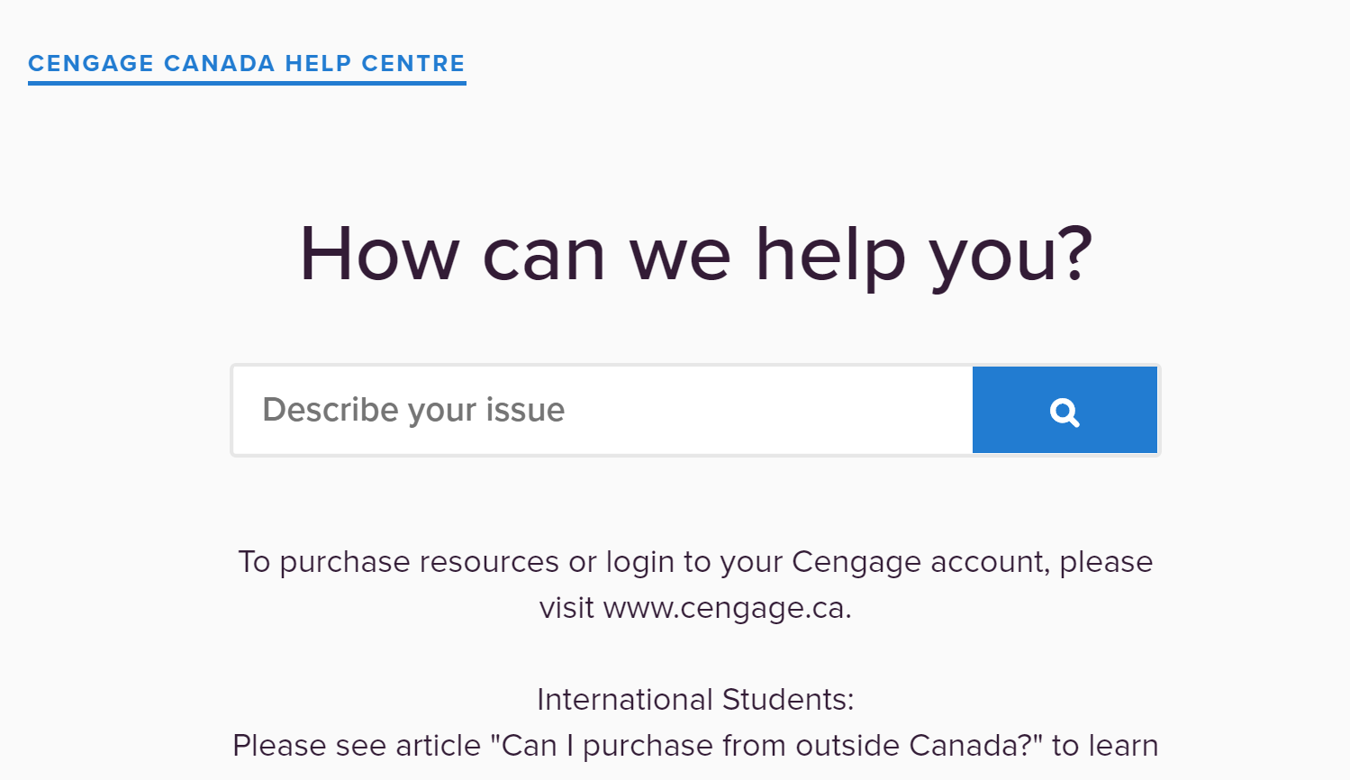

Have Questions? We’re Here to Help!
Visit our student support site at
Cengage.ca/student-support
Still Need Help?
Contact Customer Support at https://support.cengage.ca/

