Slide 1
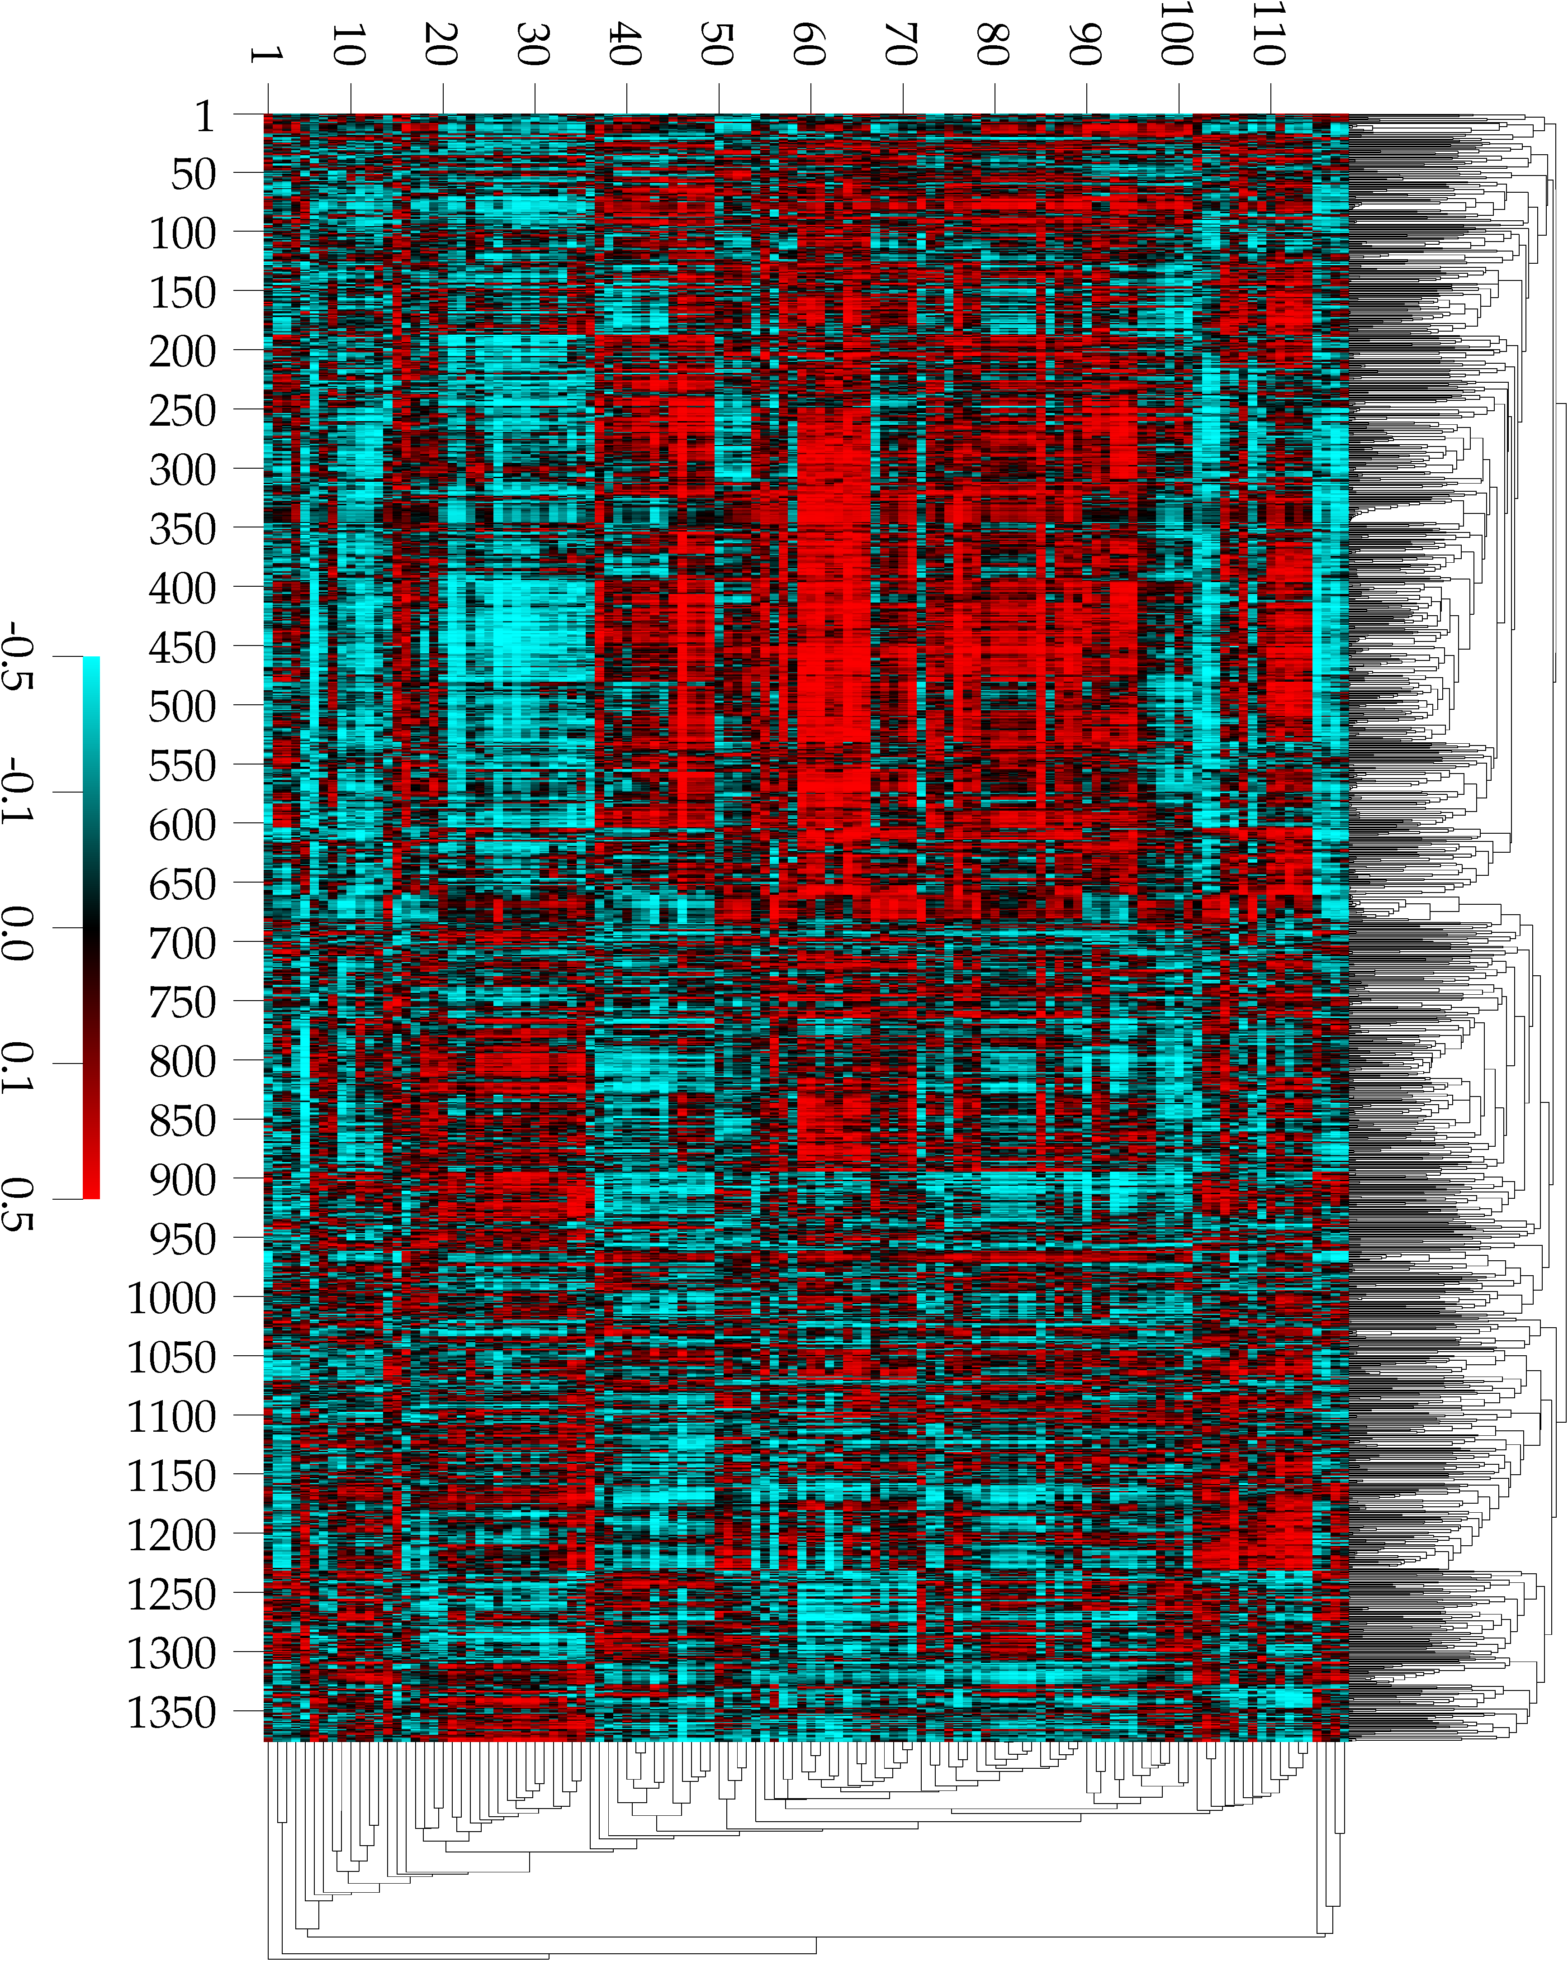
Math biology
What is it?
  Use mathematics to answer biological questions
  Use biology to pose interesting mathematical questions
﻿﻿“Mathematics is biology's next microscope, only better; biology is mathematics’ next physics, only better” (Joel Cohen, PLoS Biology 2004)
Correlation of drug activity x gene expression for 60 cancer cell lines
Scherf et al 2000

Slide 2
Outline
Sub-fields of math biology
Models for spatial patterning
What do math biologists actually do?
Resources

Slide 3
Sub-fields
Almost every biological field
(bias toward human-health-related: systems biology)
[computational/mathematical/quantitative] ×
{neurobiology, ecology, genetics, immunology …}
Most mathematical fields
(bias towards applied math)
Overlaps with statistics, computer science
(bioinformatics: genetics, comp sci, statistics, math)

Slide 4
Sub-fields
(from PubMed search)
Biology
Evolution of domesticated animals
Molecular biology of seed germination
Neurobiology and brain energy use
Gene expression and retinal angiogenesis
Cancer metastasis
Global infectious disease dynamics
…
Math (and statistics)
Bayesian network analysis
Differential equation models
Neural network models
Analysis of variance
Logistic regression
Markov chain Monte Carlo
Agent-based models
… combinatorics, linear algebra, ordinary and partial differential equations, numerical analysis, stochastic processes, game theory, …

Slide 5
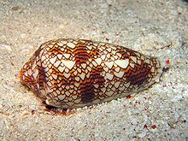
Spatial pattern formation
Formation and dynamics of spatial patterns
Within cells
Among cells
Among microbes
In ecological communities
Wikipedia

Slide 6
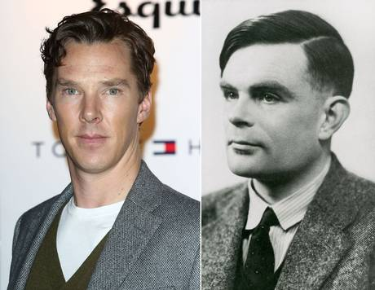
Turing patterns
Alan Turing (1912-1954)
Cryptographer, computer scientist, mathematical biologist (!)
General theory of morphogenesis
What creates biological pattern?
Independent

Slide 7
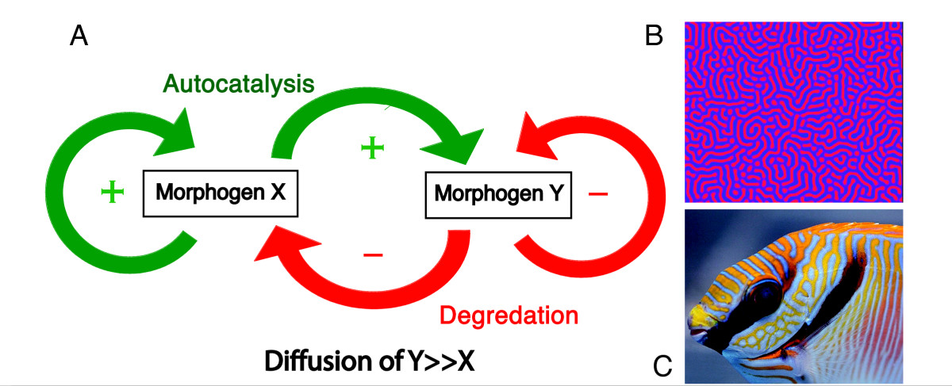
Turing’s model
Fuller (2010)

Slide 8
Turing’s model
Short-range activation (small diffusion)
Long-range inhibition (large diffusion)

Slide 9
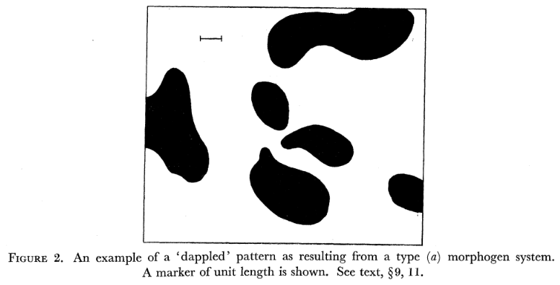
From Turing (1952)
“F﻿igure 2 shows such a pattern, obtained in a few hours by a manual computation …”
“T﻿he outlines of the black patches are somewhat less irregular than they should be due to an inadequacy in the computation procedure”

Slide 10
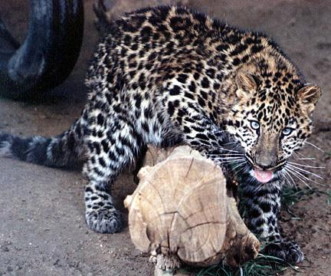
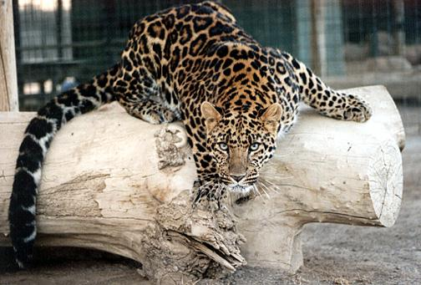
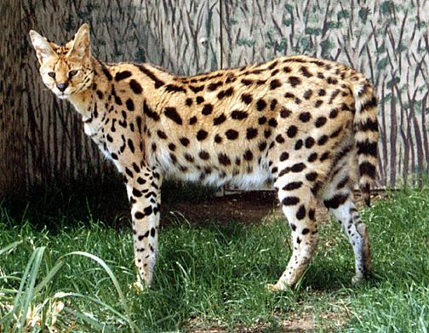
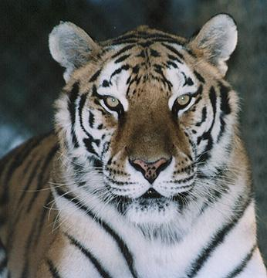
Animal coloration
EFBC Feline Conservation Center ("The Cat House")

Slide 11
Animal patterns: theory
Murray: as wavelength decreases should move from patches ➔ rings
➔ spots

Slide 12
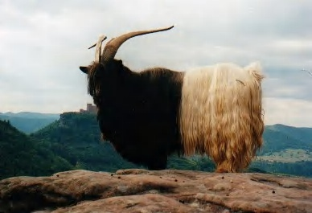
Valais goat (http://www.goatworld.com)

Slide 13
From bodies to tails
What if the wavelength stays the same but the domain size decreases?

Slide 14
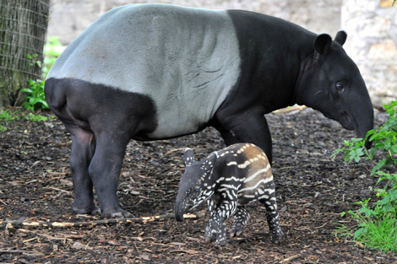
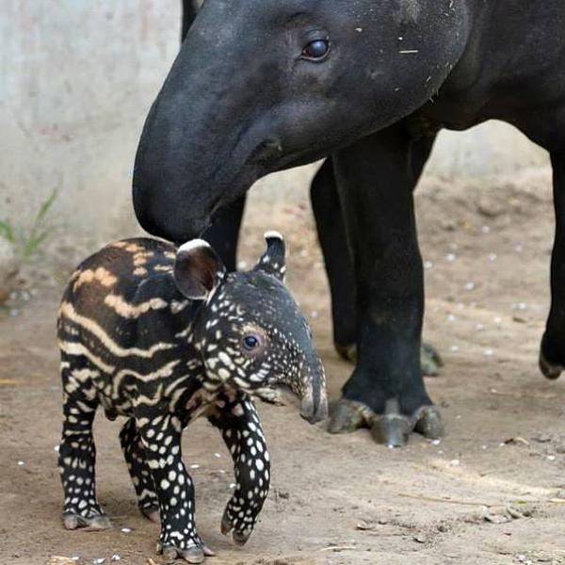
A problem for the theory?
Malayan tapir: Denver Zoo, Edinburgh Zoo

Slide 15
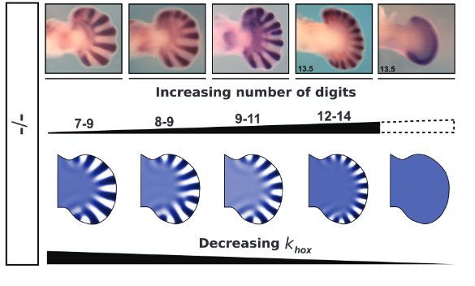
TP in developmental biology
increasing support from biologists for role in basic developmental patterns (not just colour spots)
Sheth et al. 2012

Slide 16
Microbial ecology
Unexplored world of biology
Enormous biodiversity
Complex communities
  Slime molds
  Biofilms (quorum sensing)
  Microbiome
Partial differential equations, evolutionary game theory

Slide 17
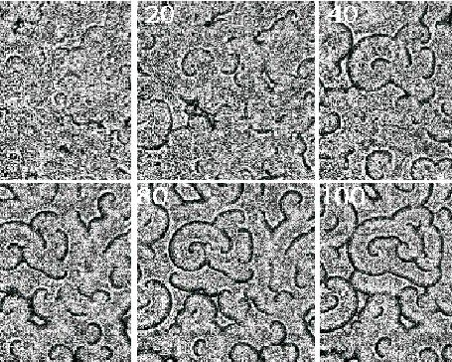
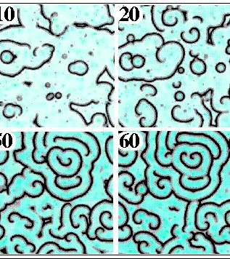
Dynamic patterns and cooperation
Slime molds
(Dictostyleum discoideum)
Alternate between
  single-celled individual
  multi-celled “slug” & “stalk”
When food gets scarce, send out cyclic AMP signals
How do patterns arise?
(PDEs)
What prevents cheating?
(Evolutionary game theory)

Slide 18
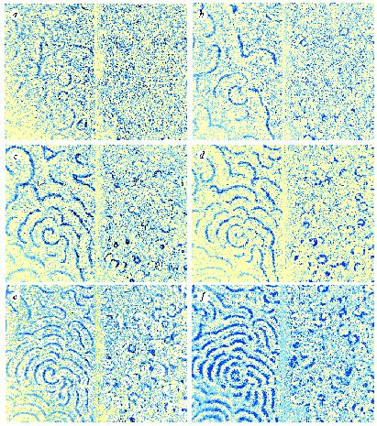
Slime mold model
Too complicated to show here
Predicts which signaling molecule drives patterns
Turning off that gene in model destroys pattern
… and in experiment!
Palsson et al 1997
Left: wild-type, right: mutant

Slide 19
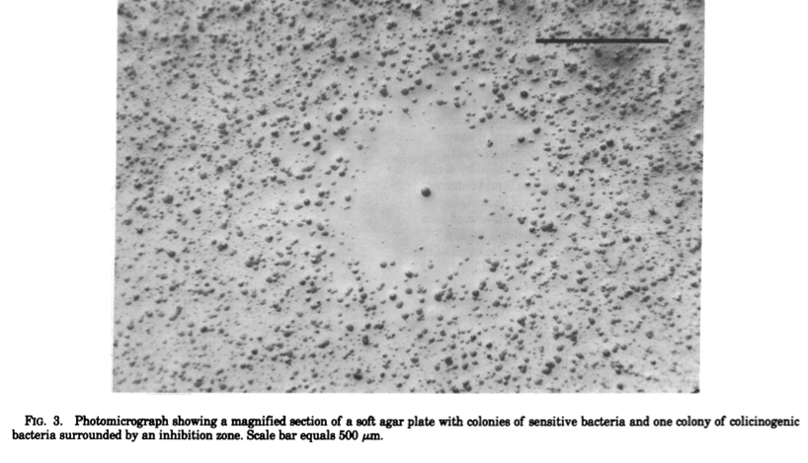
Microbial ecology: competition
Some strains of E. coli produce colicin (antibacterial)
Poisons neighbours
Energetically expensive
Chao and Levin 1981

Slide 20
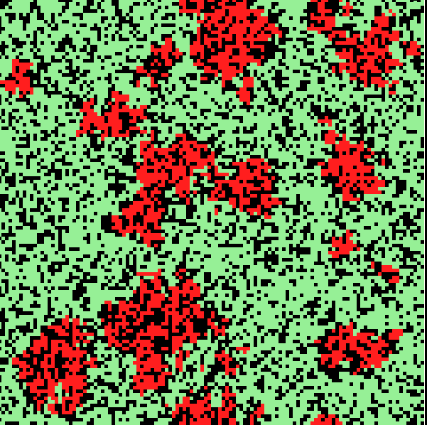
Colicin: spatial competition model
Colicin is expensive
Colicin-resistant but non-producing strains beat colicin producers
Rock-paper-scissors
Spatial structure and discrete individuals required for coexistence
Durrett and Levin 1997

Slide 21
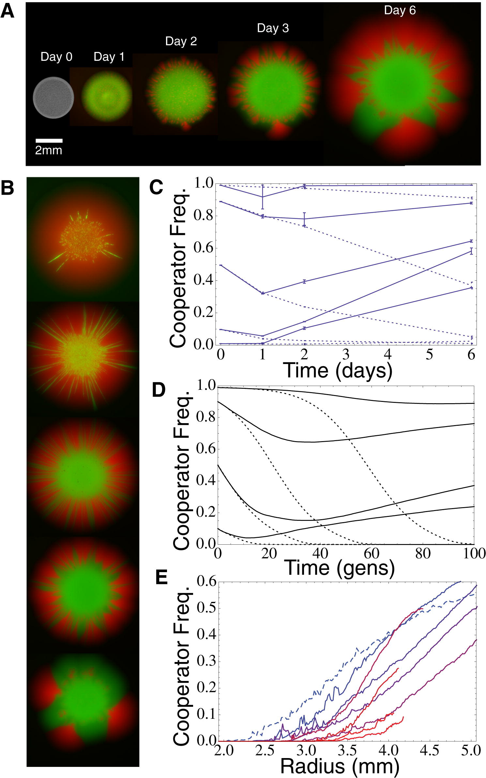
Resource use: game theory
“Cooperators” produce enzymes to break down sugars and release them into the environment
Model and experiment: “cooperators” win at boundary

Slide 22
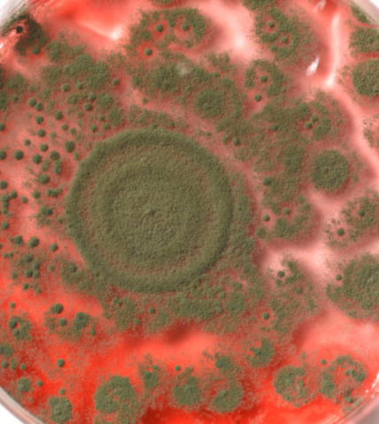
Another puzzle
Stock photo
(from aCBC programme on antibiotic resistance )
Is it real?
What mechanisms are required to produce these patterns?
  Non-local dispersal?
  Non-local competition?

Slide 23
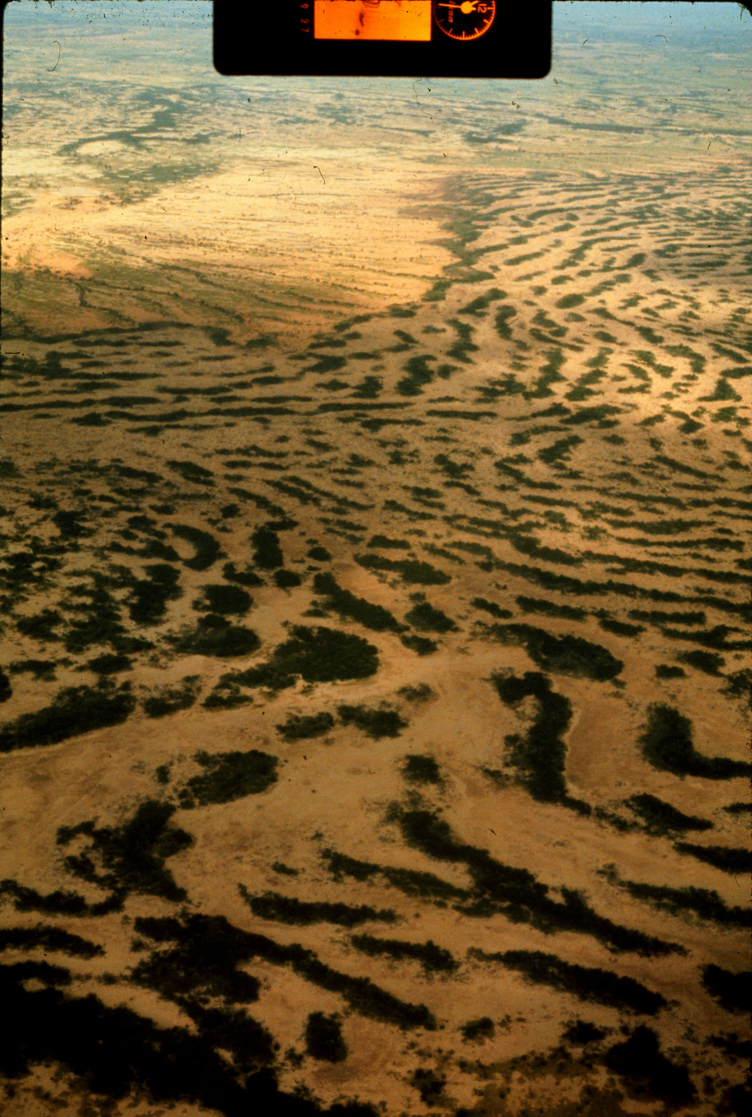
Ecology: tiger bush
Vegetation pattern of semi-arid regions
Ranges from stripy to patchy
What’s going on?
Too big/slow for experiments

Slide 24
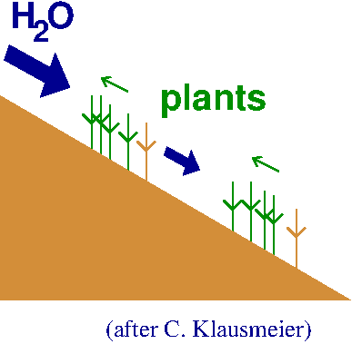
Tiger bush: conceptual model

Slide 25
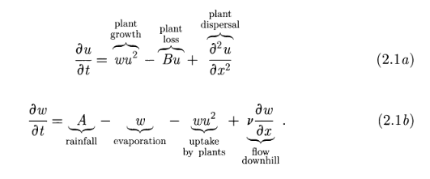
Tiger bush: math model
Another simple PDE model (Klausmeier 1999)
Both diffusion (spread, ∂²u/∂x² ) and advection (directional movement, ∂w/∂x )

Slide 26
How does math biology actually work?
Applied math; basic or applied biology
Write down equations that describe how the system works
Try to solve them
Fail
Do something else
Try to figure out what the results mean
Estimate parameters
Try to figure out what the results really mean

Slide 27
Techniques
Approximation (e.g. Taylor expansion; perturbation analysis)
Analysis (prove existence and uniqueness of solutions)
Numerical solutions
Stochastic models
Search and optimization algorithms
Statistical analysis;
parameter estimation

Slide 28
Equilibrium and stability analysis
SIR (susceptible/
infected/
recovered)
equations
S
I
R

Slide 29
Equilibrium analysis
Equilibrium (“trivial”, “disease-free”): I*=0
What if I is small but not zero?
dI/dt = (βS-γ)I
If I stays small, S approximately constant then
I increases exponentially if βS>γ: equilibrium is unstable

Slide 30
Stability analysis: Turing equations
Write down equations
Homogeneous state is an equilibrium state
Allow small perturbation
Calculate growth or decay of perturbations
as a function of wavelength
Find least stable wavelength: if it’s unstable, then pattern grows (at least initially)

Slide 31
Courses
Essential
Calculus (1XX3)
Ordinary differential equations (2C03)
Linear algebra (1B03)
Probability and statistics (STATS 2D03, 2MB3)
Intro to modeling (3MB3)
Some programming course (1MP3 or ?)
Useful
Numerical analysis (2T03)
More calculus (1XX3)
More ODEs (3F03)
More lin alg (2R03)
PDEs (3FF3)
Stochastic processes (STATS 3U03)
Analysis (3A03)
Combinatorics (3U03)
Math biology! (4MB3)

Slide 32
Things I’ve done
Understanding measles dynamics
Eco-evolutionary dynamics of virulence
Spatial pattern formation in ecological systems, and feedback on competition
Spatial epidemic patterns
Using genetic markers to estimate sea turtle movements
Movement behaviour of Florida panthers
Carbon cycling in terrestrial ecosystems

Slide 33
MB resources @ Mac
Biology & math honours programme
Courses:
  MATH 1B03 (linear algebra), 2X03 (advanced calculus); 2R03 (differential equations); 3MB3 (intro to modeling); BIO 3S03, 3SS3, 3FF3
People:
  Math & stats: Bolker, Earn, Lovric, Wolkowicz
  Bio: Bolker, Dushoff, Golding, Stone
  Biophysics: Higgs
  PNB: Becker
  probably others I’m forgetting!
http://ms.mcmaster.ca/mathbiol/

Slide 34
More resources
    Recent journal articles: tinyurl.com/biomath000
    K. Sigmund, Games of Life
    R. Dawkins, The Selfish Gene
    H. Kokko, Modeling for Field Biologists and other Interesting People

